Slide 1

Purpose and Nature of the Following Balance Day Adjustments
Accounting & Finance
Year 11 2023

Slide 2
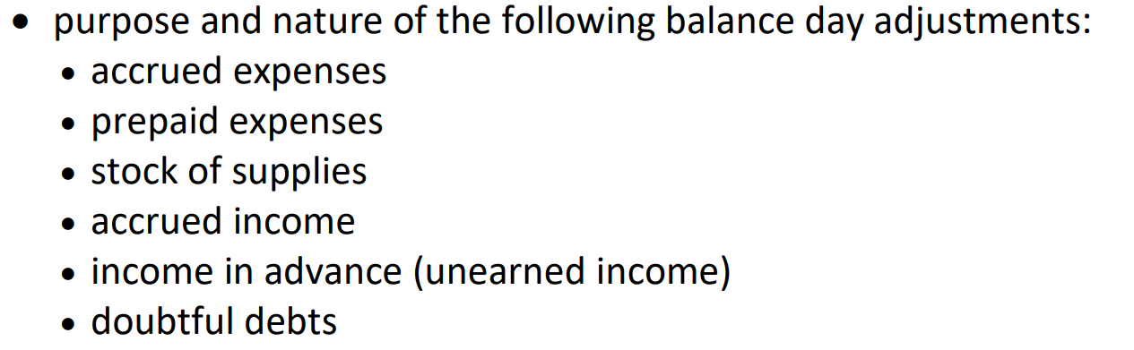

Slide 3
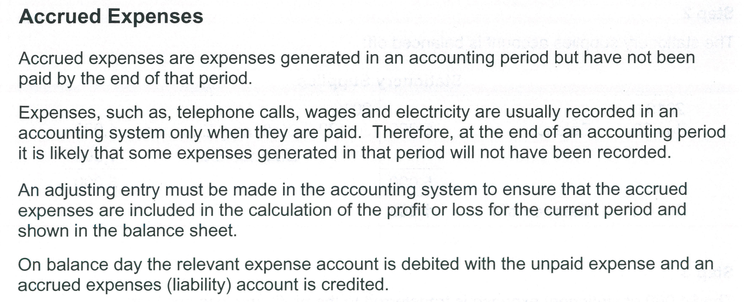
1

Slide 4
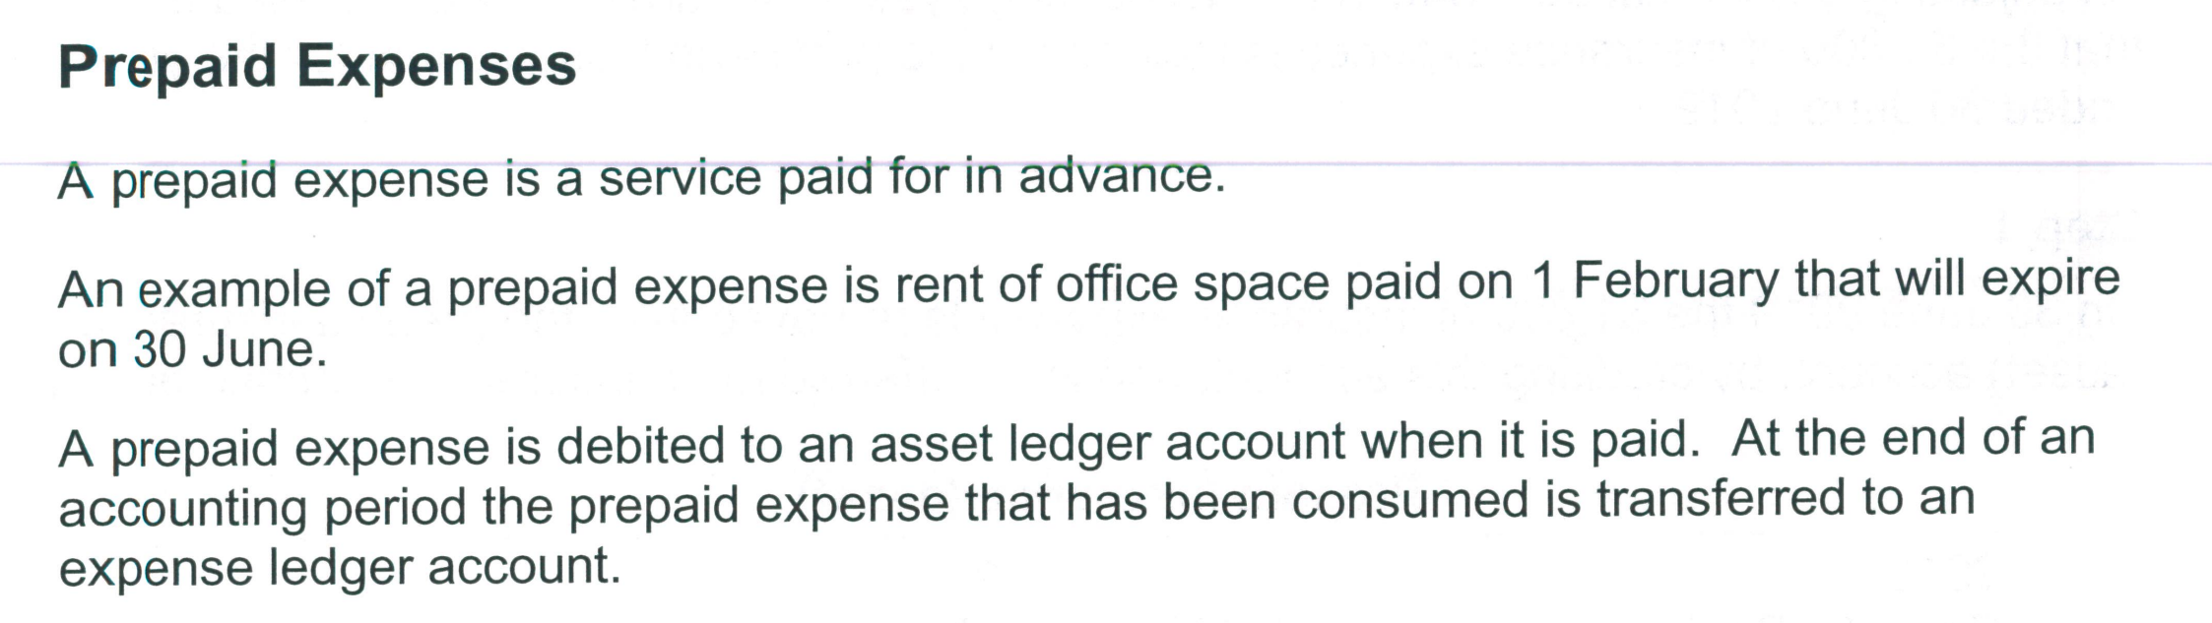
2

Slide 5
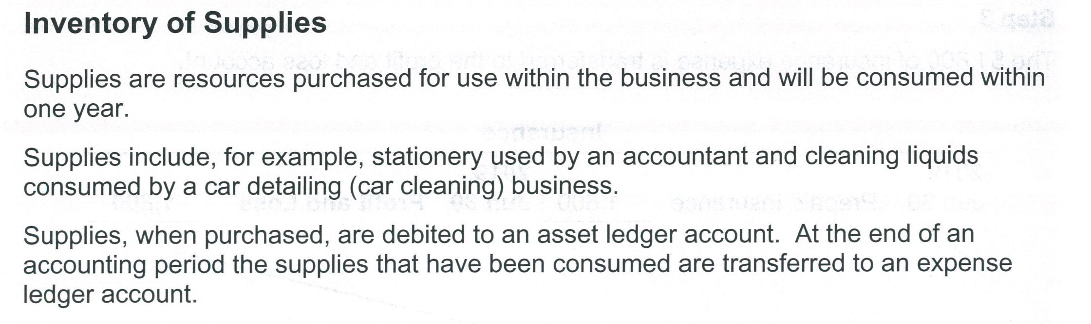
3

Slide 6
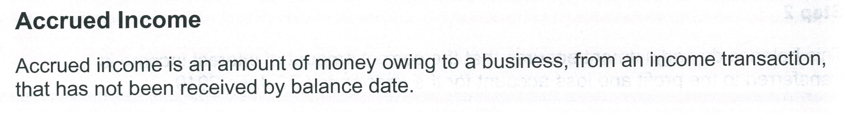
4

Slide 7
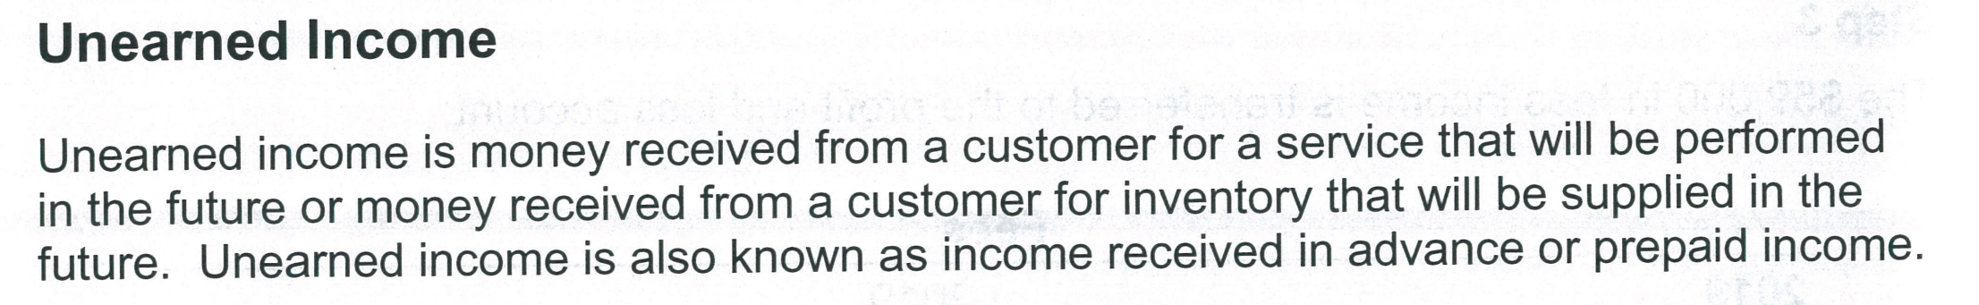
5

Slide 8
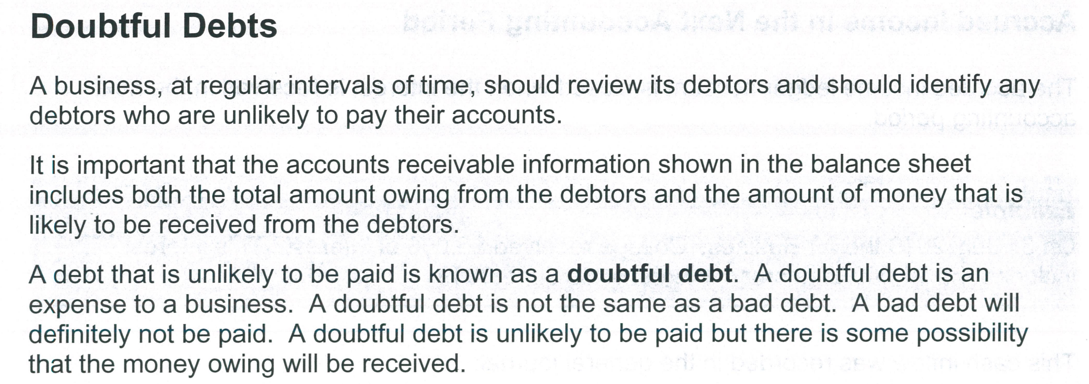
6

Slide 9
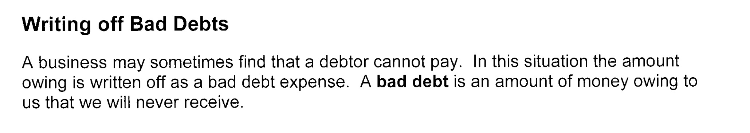

Slide 10
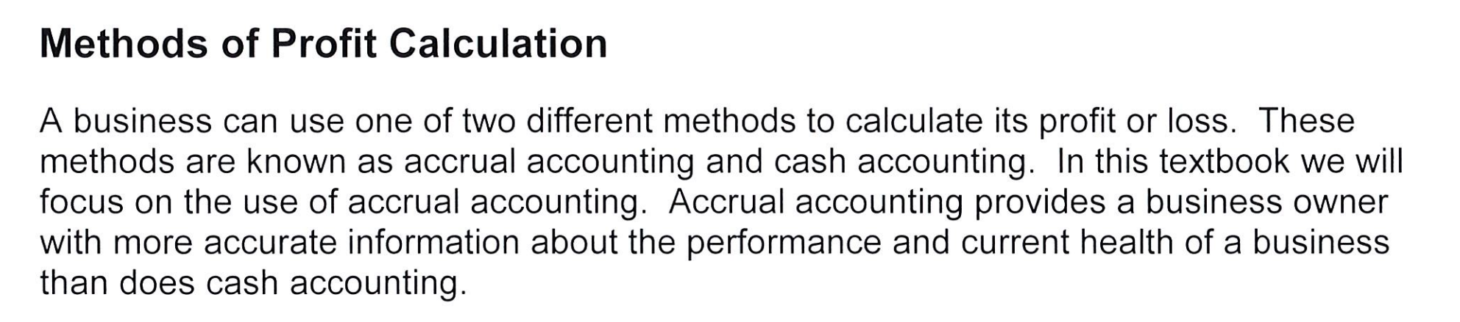

Slide 11
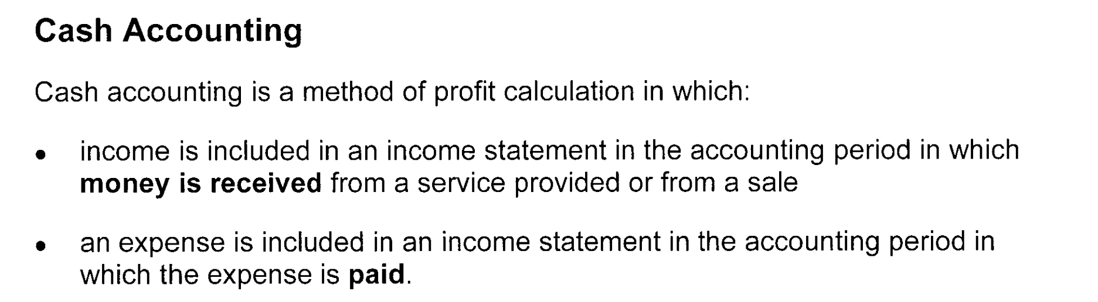

Slide 12
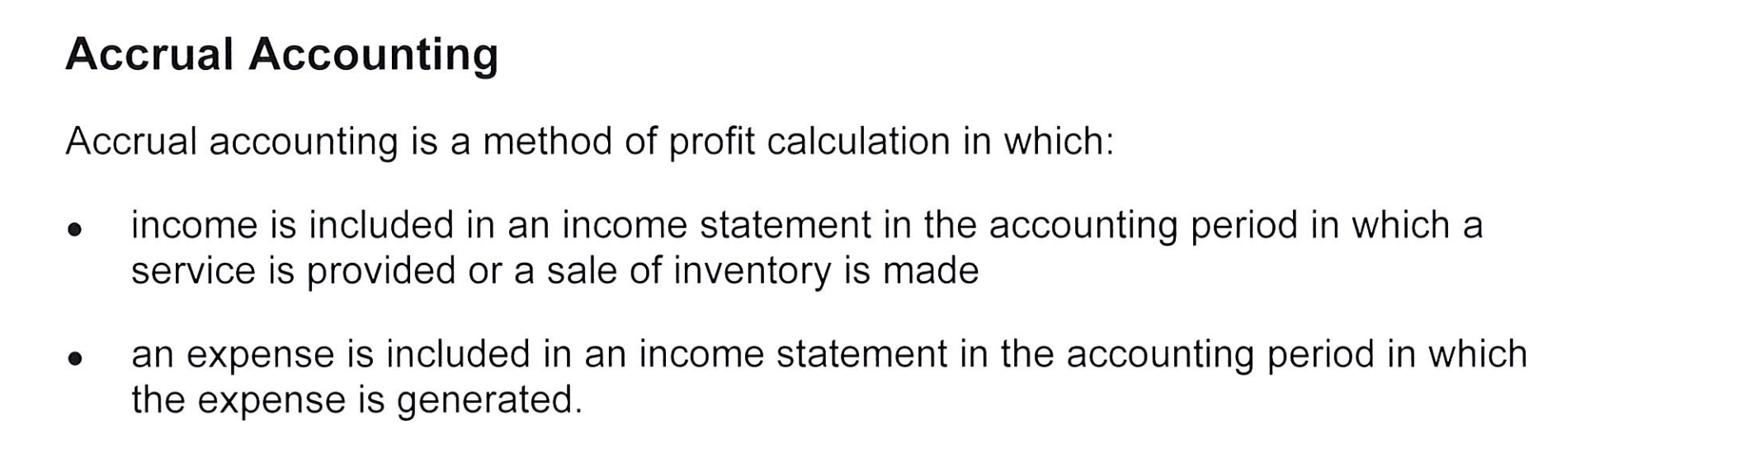

Slide 13
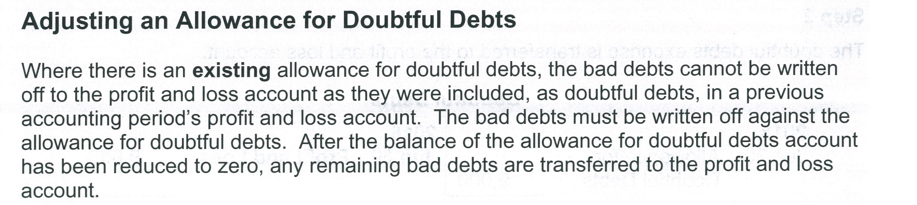

Slide 14

The Conceptual Framework Elements

Slide 15
Assets
The elements are defined in the Conceptual Framework (CF) as follows:
An asset is ‘a present economic resource controlled by the entity as a result of past events.’ (CF, Table 4.1)
An economic resource is defined as ‘a right that has the potential to produce economic benefits.’ (CF, 4.3)
The three aspects of the definition of an asset are:
right
potential to produce economic benefits, and
control. (CF, 4.4)

Slide 16
Liabilities
A liability is ‘a present obligation of the entity to transfer an economic resource as a result of past events.’ (CF, 4.26)
The three criteria that must exist for a liability to exist are:
‘the entity has an obligation
the obligation is to transfer an economic resource
the obligation is a present obligation that exists as a result of past events.’ (CF, 4.27)
Equity is ‘the residual interest in the assets of the entity after deducting all its liabilities.’ (CF, 63)
Income is ‘increases in assets, or decreases in liabilities, that result in increases in equity, other than those relating to contributions from holders of equity claims.’ (CF, 4.68)
Expenses are ‘decreases in assets, or increases in liabilities, that result in decreases in equity, other than those relating to distributions to holders of equity claims.’ (CF, 4.69)

Slide 17
Recognition:
Framework.
The Conceptual Framework states that ‘Only items that meet the definition of an asset, a liability or equity are recognised in the statement of financial position. Similarly, only items that meet the definition of income or expenses are recognised in the statement(s) of financial performance. However, not all items that meet the definition of one of those elements are recognised.’
The Conceptual Framework outlines that ‘An asset or liability is recognised only if recognition of that asset or liability and of any resulting income, expenses or changes in equity provides users of financial statements with information that is useful,’ i.e. with:
relevant information about the asset or liability and about any resulting income, expenses or changes in equity; and
a faithful representation of the asset or liability and of any resulting income, expenses or changes in equity .’

Slide 18
Faithful Representation
As defined in the qualitative characteristics of the Conceptual Framework, ‘To be useful, financial information must not only represent relevant phenomena, but it must also faithfully represent the substance of the phenomena that it purports to represent‘ and ‘To be a perfectly faithful representation, a depiction would have three characteristics. It would be complete, neutral and free from error.’

Slide 19
Relevance
As defined in the qualitative characteristics of the Conceptual Framework, ‘Relevant financial information is capable of making a difference in the decisions made by users. Information may be capable of making a difference in a decision even if some users choose not to take advantage of it or are already aware of it from other sources.’
According to the Conceptual Framework, an asset or liability may not be recognised if:
‘it is uncertain whether or not the asset or liability exists,’ or
‘it may exist, but the probability of an inflow or outflow of economic benefits is low.’

Slide 20
Measurement
According to the Conceptual Framework, for an asset or liability to be recognised it must be measured.
The level of measurement uncertainty associated with the asset or liability may impact on whether a faithful representation can be provided of the item.
Measurement uncertainty is defined as ‘uncertainty that arises when monetary amounts in financial reports cannot be observed directly and must instead be estimated.’
Measurement requires the elements to be able to be quantified in monetary terms. To be able to quantify or measure with certainty the elements, the business must select a measurement basis, i.e. either historical cost or current value (current value includes fair value, value in use/fulfilment value or current cost).

Slide 21
Recognition
The Conceptual Framework points out that recognition links the elements in the statement of financial position (i.e. assets, liabilities and equity) and the elements in the statement of financial performance (i.e. income and expenses).
The link between the two statements arises because the recognition or change of one item requires the recognition, or derecognition, of one or more other
items.
Derecognition is defined as ‘the removal of all or part of a recognised asset or liability from an entity’s statement of financial position.’

Slide 22
Measurement
According to the Conceptual Framework, for an asset or liability to be recognised it must be measured.
The level of measurement uncertainty associated with the asset or liability may impact on whether a faithful representation can be provided of the item.
Measurement uncertainty is defined as ‘uncertainty that arises when monetary amounts in financial reports cannot be observed directly and must instead be estimated.’
Measurement requires the elements to be able to be quantified in monetary terms.

